Slide 1
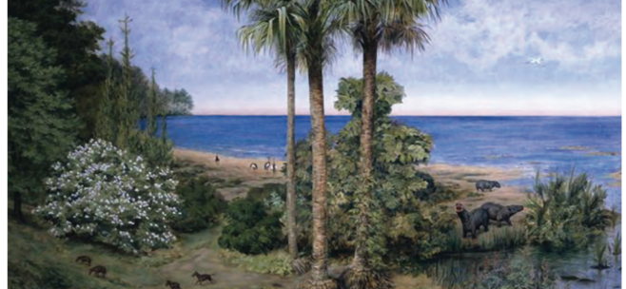
Eocene Flora (55.8-33.9 MA)
At the beginning of the Eocene, the high temperatures and warm oceans created a moist, balmy environment, with forests spreading throughout the Earth from pole to pole. Tropical rainforests grew as far north as northern North America and Europe. Palm trees were growing as far north as Alaska! Cooling began mid-epoch, and by the end of the Eocene some places had begun to dry out. Deciduous trees (trees that lose their leaves in the winter) were better able to cope with large temperature changes and became more common.

Slide 2
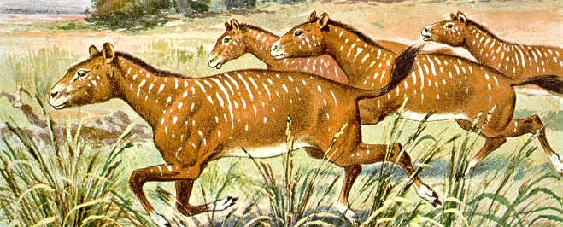
Oligocene Flora (33.9-23 MA)
Grasslands began to expand and forests (especially tropical ones) began to shrink. Grasses, a product of the cooler, drier climate, became one of the most important kinds of plants. As they spread over several million years, grasses fed herds of grazing animals, smaller animals and birds, and stabilized soil, which in turn reduced erosion. Grasses are high-fiber, low-protein plants and must be eaten in large quantities to provide enough nutrition. Because they contain tiny silica (glass) fragments, though, they are tough to chew and wear down animal teeth. However, even at the end of the epoch, grass was not as common as one would observe in a modern savannah today.

Slide 3
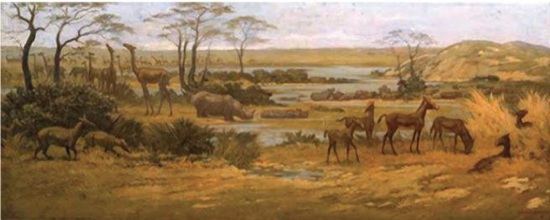
Miocene Flora (23-5.3 MA)
Plants continued to adapt to higher light intensity and higher temperatures. This resulted in more gritty, tough, fire-tolerant grasses. Grazing is a method of feeding in which herbivores (plant eaters) feed. on low-growing plants such as grasses led to a major expansion of grass-grazer ecosystems. There were many herds of large, swift grazers pursued by predators across open grasslands.

Slide 4
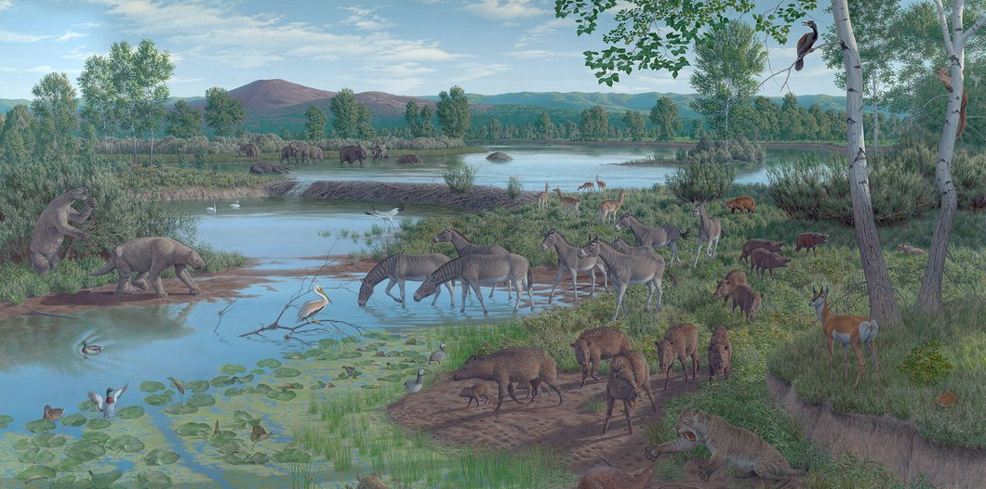
Pliocene Flora (5.3-2.6 MA)
Tundra covered much of the north, and grasslands spread on all continents. Tundra’s have cold temperatures, little rain, poor nutrients, and short growing seasons. In the lower latitudes, grasslands are marked by fewer and fewer trees. These habitats offer limited food sources for animals and support less diversity.

Slide 5
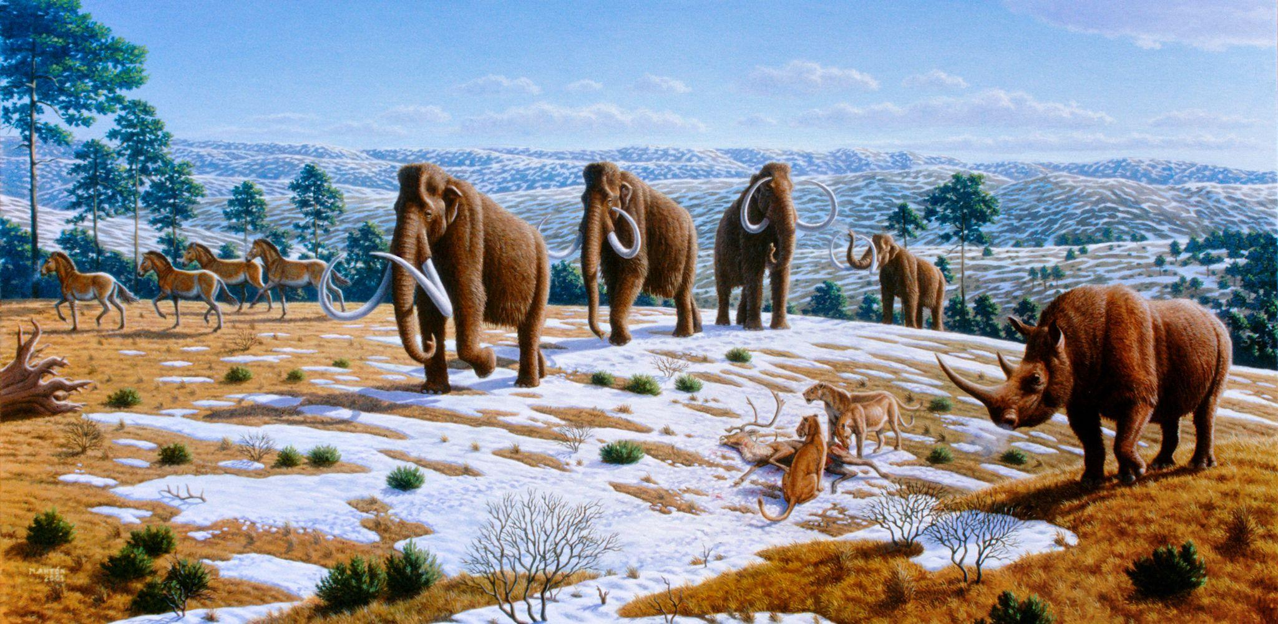
Pleistocene Flora (2.6-0.01 MA)
During the Pleistocene, glaciers repeatedly spread from the Arctic north over Europe and North America. As the ice advances, temperatures ahead of the glaciers drop significantly. The temperature change has a big impact on life. Mammoths, rhinos, bison, reindeer, and musk oxen all evolve to have warm, woolly coats to protect them from cold conditions. These new mammals feed on the small bushes and hardy grasses that tolerate cold as they follow the moving line of glaciers.

